Slide 1
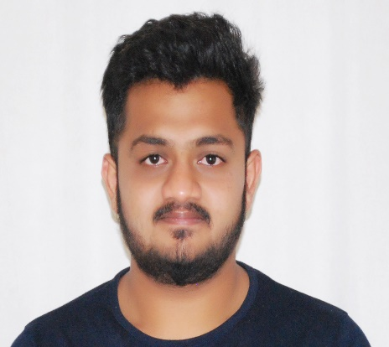
Dhanush T N
Education: BE in Telecommunication Engineering from RV College of Engineering
Hobbies: Reading, Gaming, Cricket and Cooking
What defines you: (2 lines about you) I am one who is always open to learn new things and sort of a live in the present kind of a person.

